Slide 1

Rain in Australia - Next-Day Prediction Model

Slide 2
Project Summary
The rainfall parameters in this study are collected, trained and tested to achieve the sustainable results.
The monthly rainfall predictions obtained after training and testing are then compared with actual data to ensure the accuracy of the model.

Slide 3
Problem Statement
Predict whether or not it will rain tomorrow by training a various classification models on target RainTomorrow.
The target variable RainTomorrow means:
Did it rain the next day? Yes or No.

Slide 4
DATA SOURCE:
Dataset is collected from Kaggle.
Observations were drawn from numerous weather stations. The daily observations are available from http://www.bom.gov.au/climate/data. Copyright Commonwealth of Australia 2010, Bureau of Meteorology.
This dataset is also available via the R package rattle.data

Slide 5
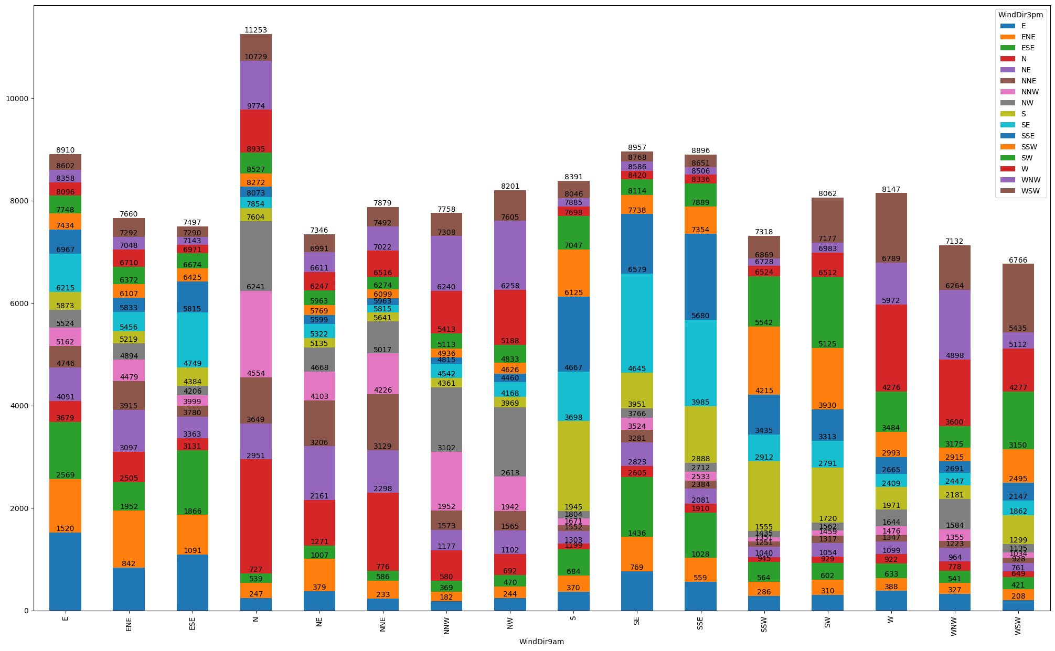
Data Relationships: Exploring how different variables interact with each other.

Slide 6
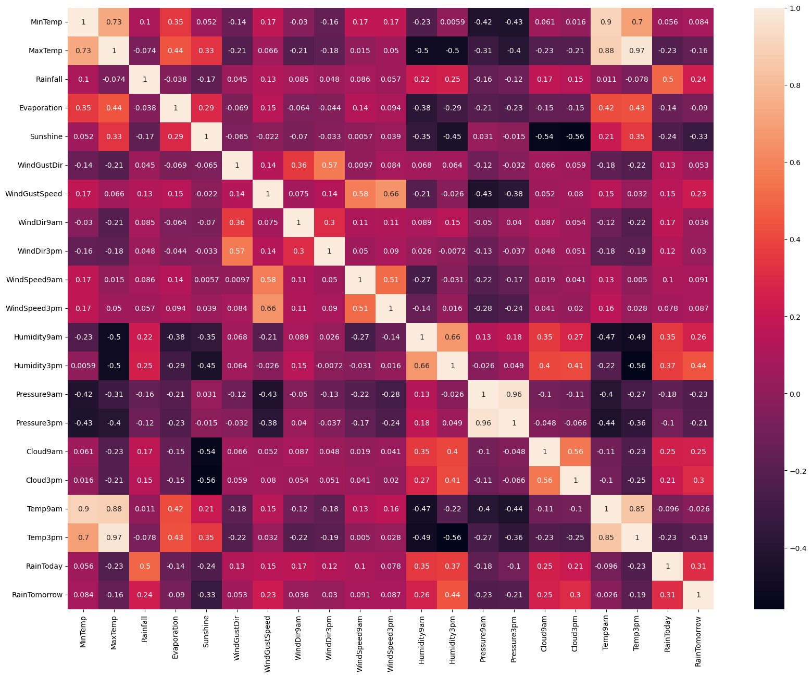
HEAT MAP: Using heatmap visualizations to highlight relationships in a multivariate setting.

Slide 7
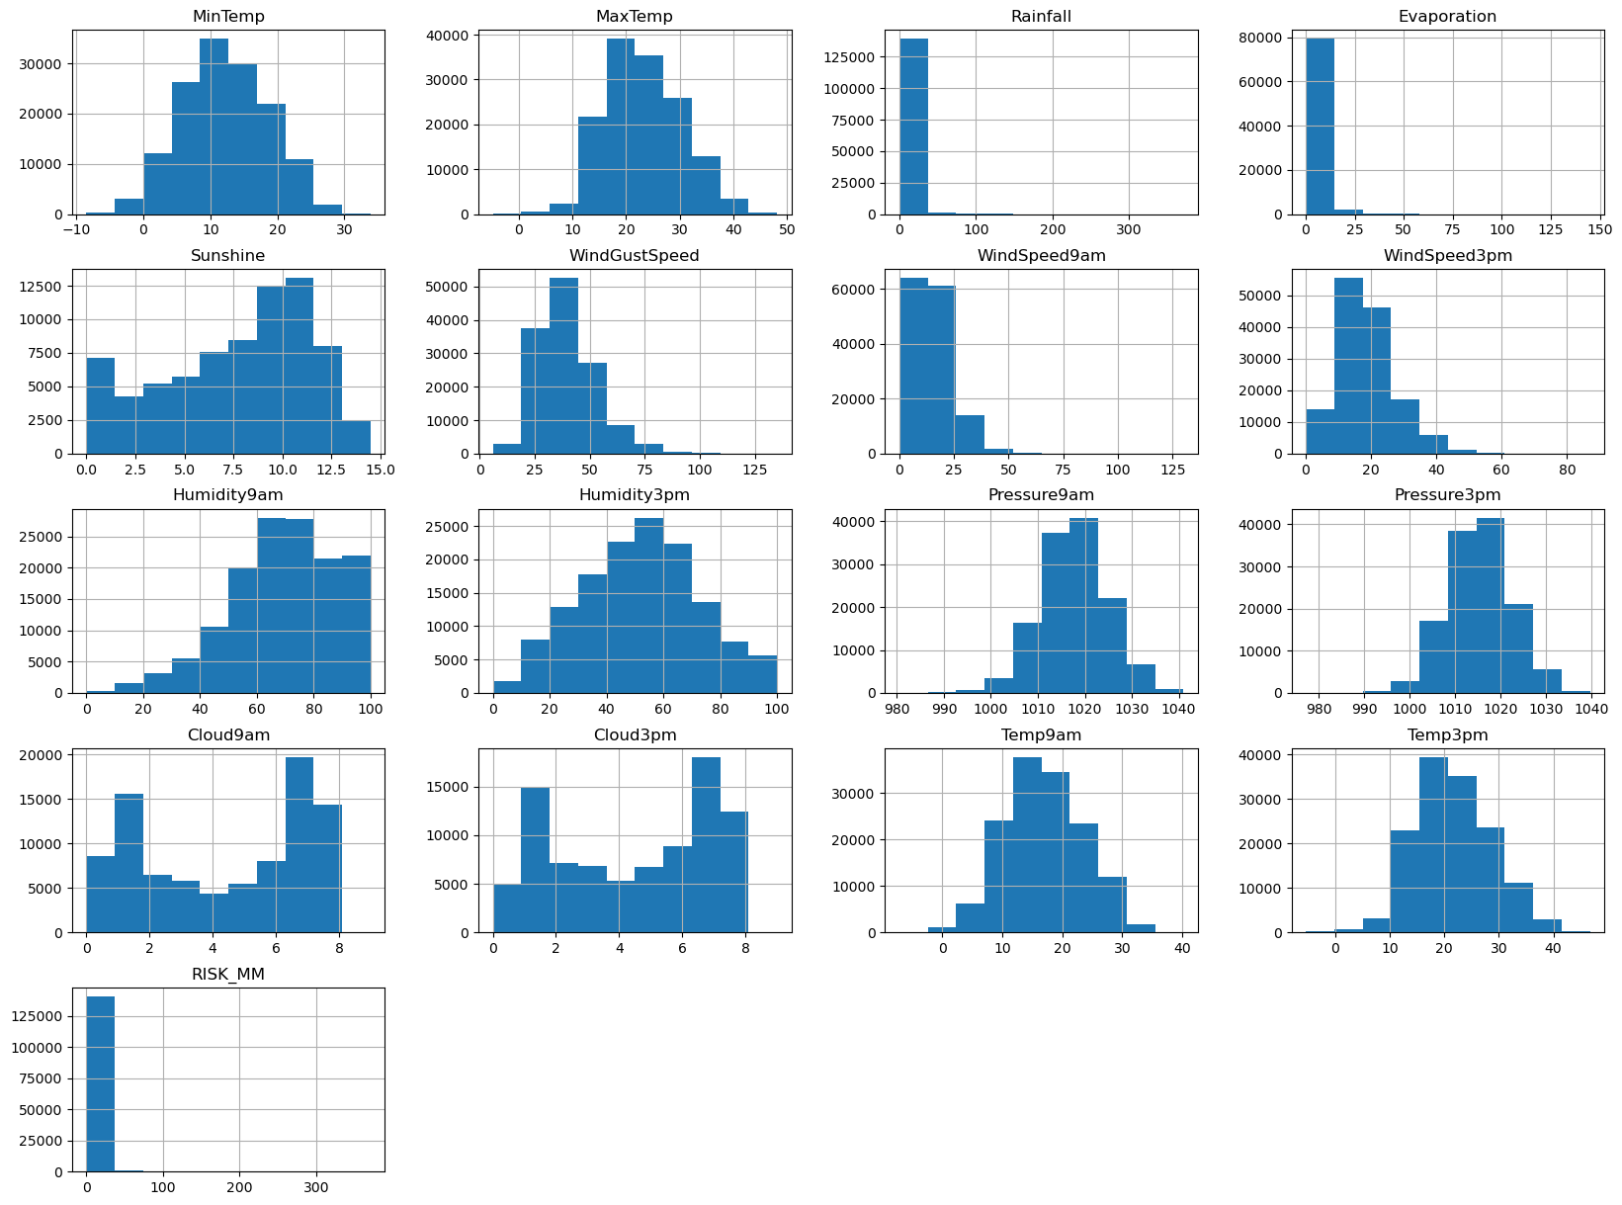
Data Distribution: Understanding the distribution of each variable in the dataset. Identifying the presence of outliers, skewness, or any unusual patterns.

Slide 8
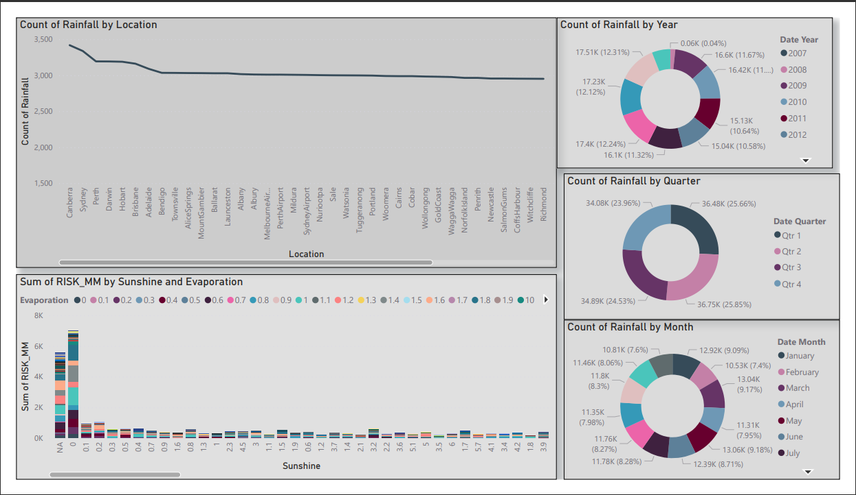
Creating Dashboard’s for understanding the various Features.

Slide 9
Risks & Challanges
Encoding
Feature Selection

Slide 10
Results & Conclusion:
Best Models in terms of accuracy (In my Experiment):
1) XG Boost Model
2) Decision Tree Classifier
3) Gradient Boost Classifier
Best Models in terms of Computation Time (In my Experiment):
1) Logistic Regression
2) Decisoin Tree Classifier
3) XG Boost Model

Slide 11
CONCLUSION:
The Ensemble model XG Boost is performing well when compared with Other models like Logistic Regression,Random Forest,Decision Tree and GradientBoost.
But XG Boost model consumes more time to train the model.

